Slide 1
Girls Can Do Math
One woman’s story of how her love for math led her to computer programming … 70 years ago
A presentation to the Farmington Historical Society
By Patricia Overall
Monday, October 26, 2025

Slide 2

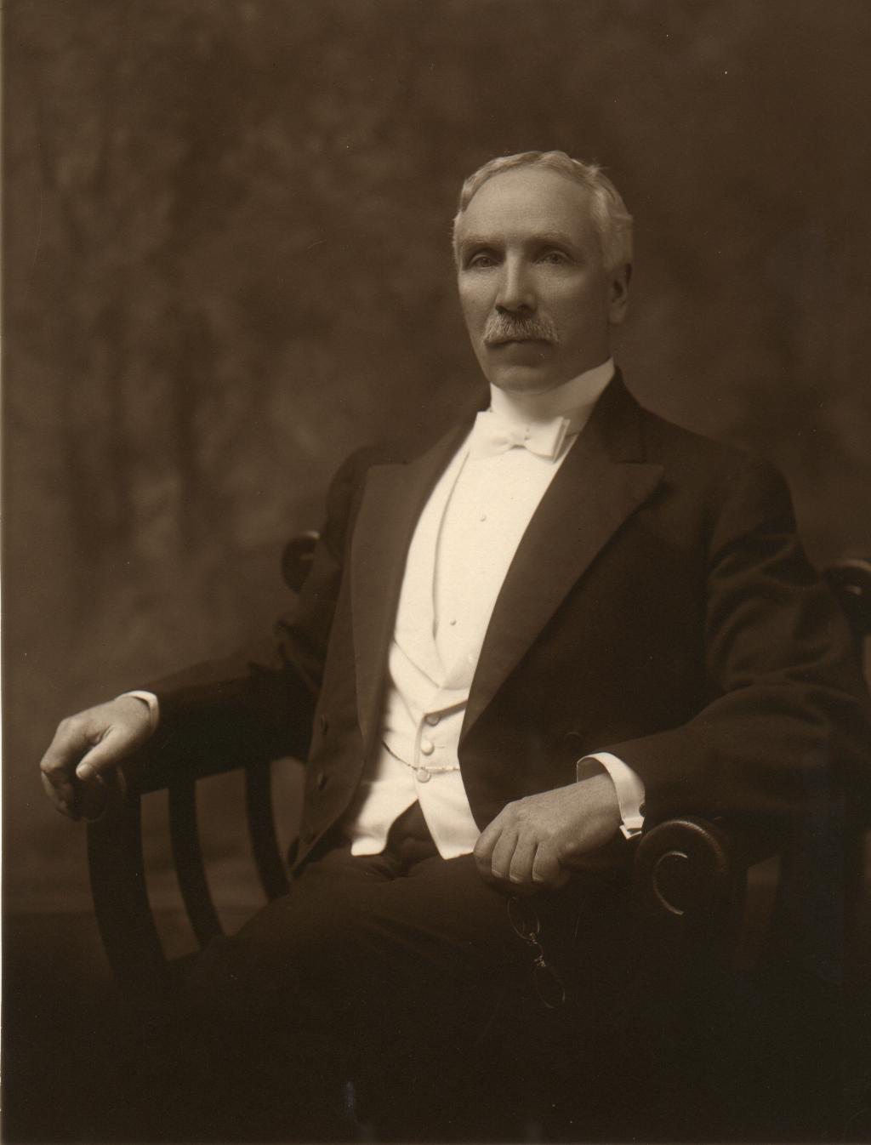
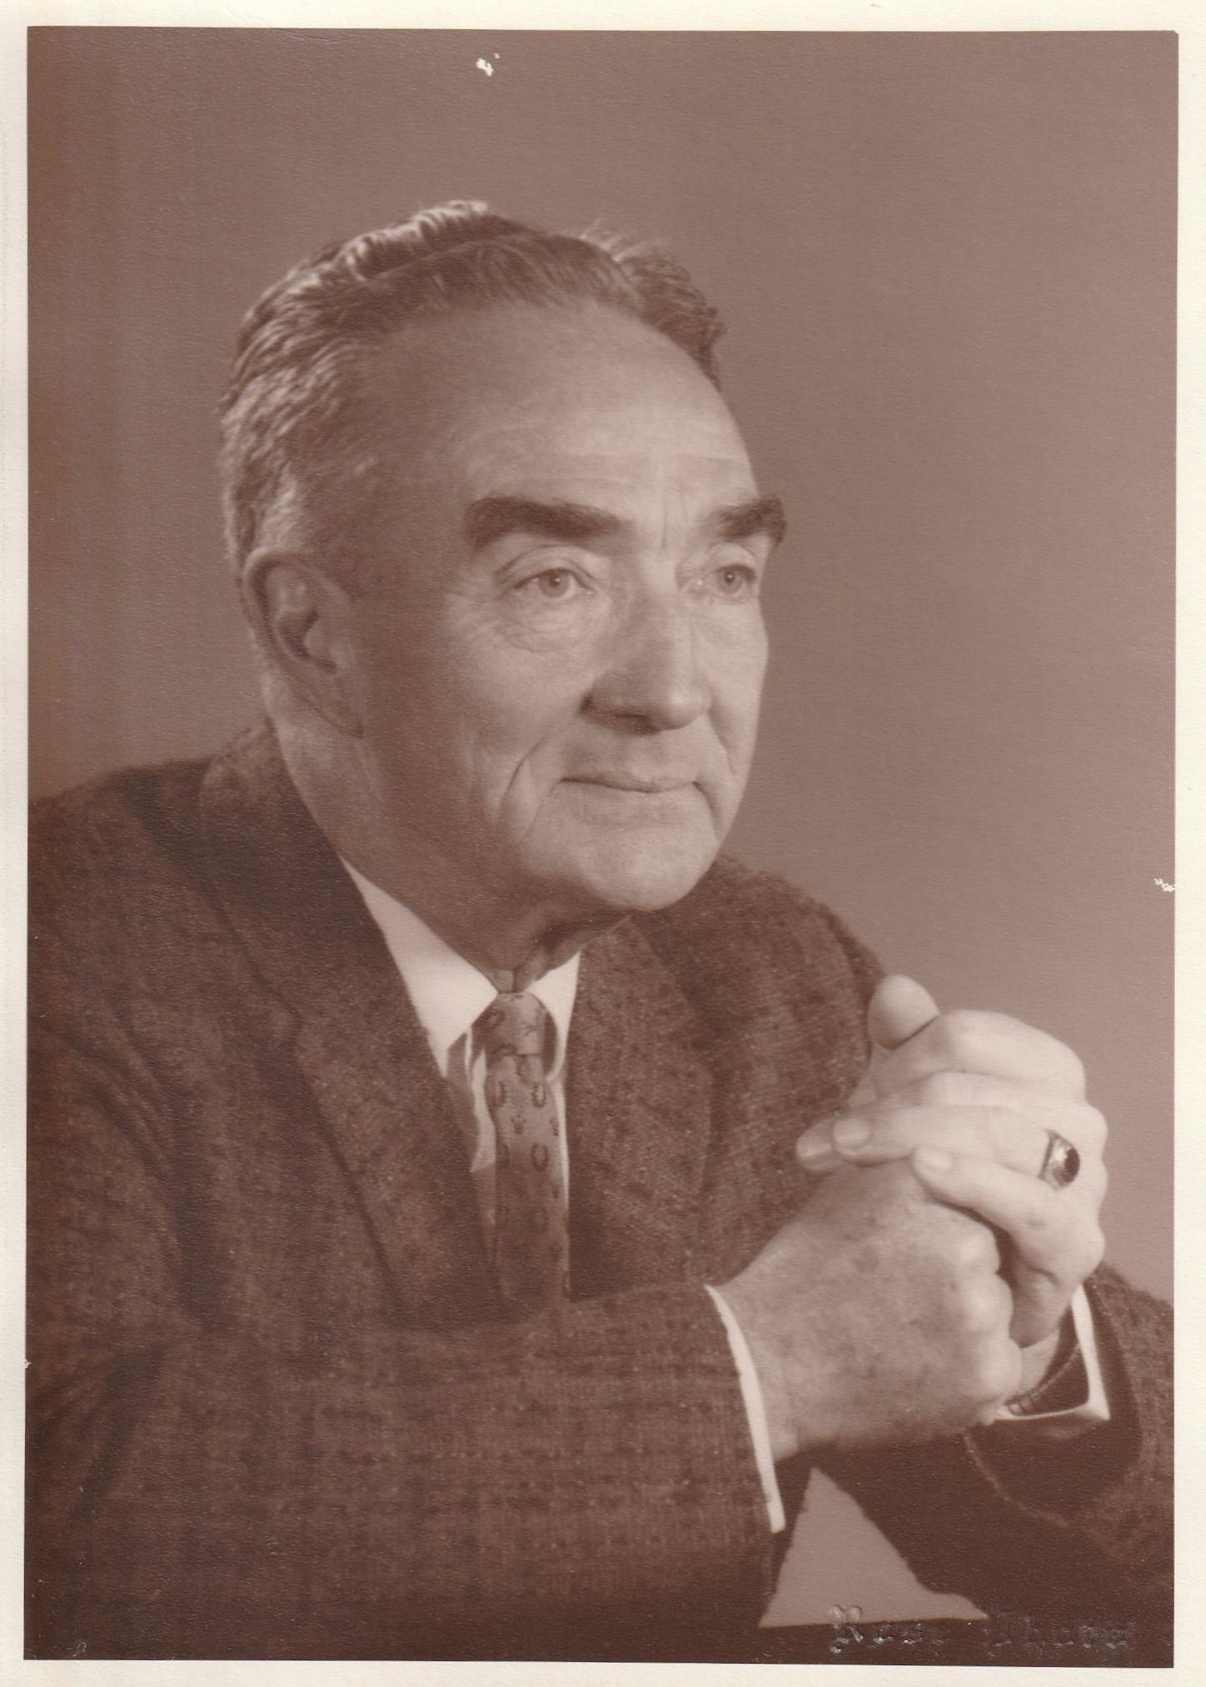
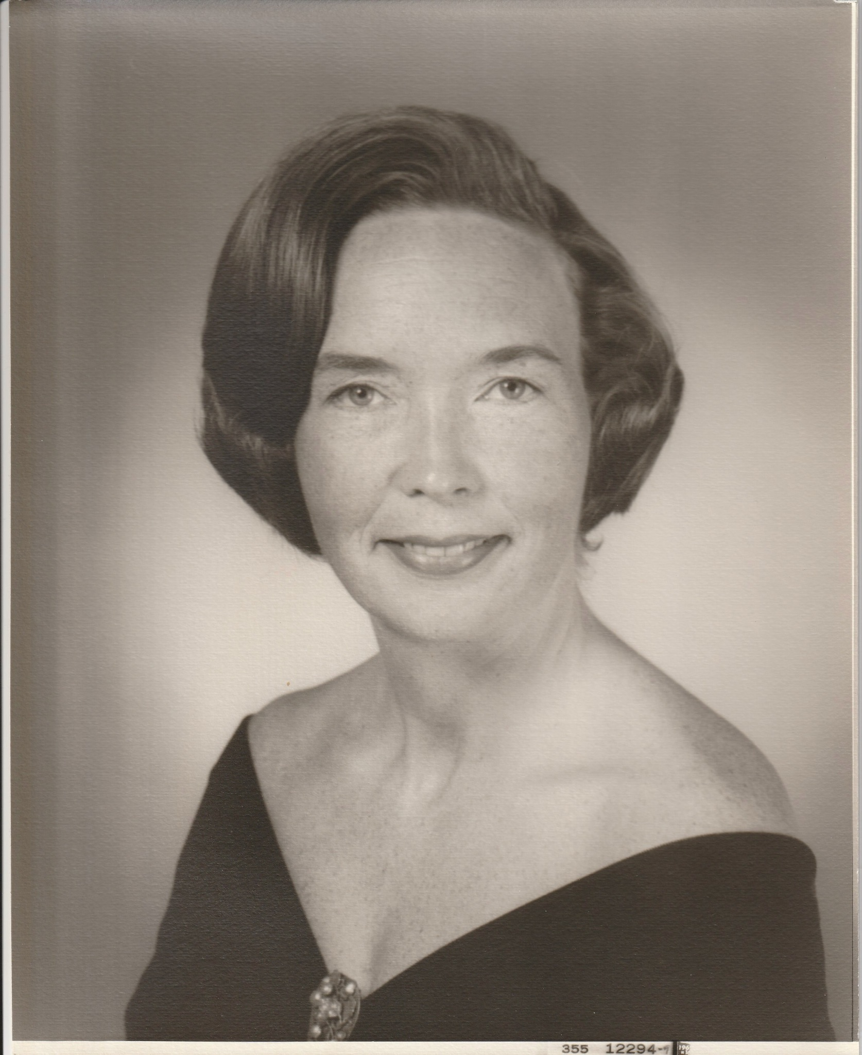
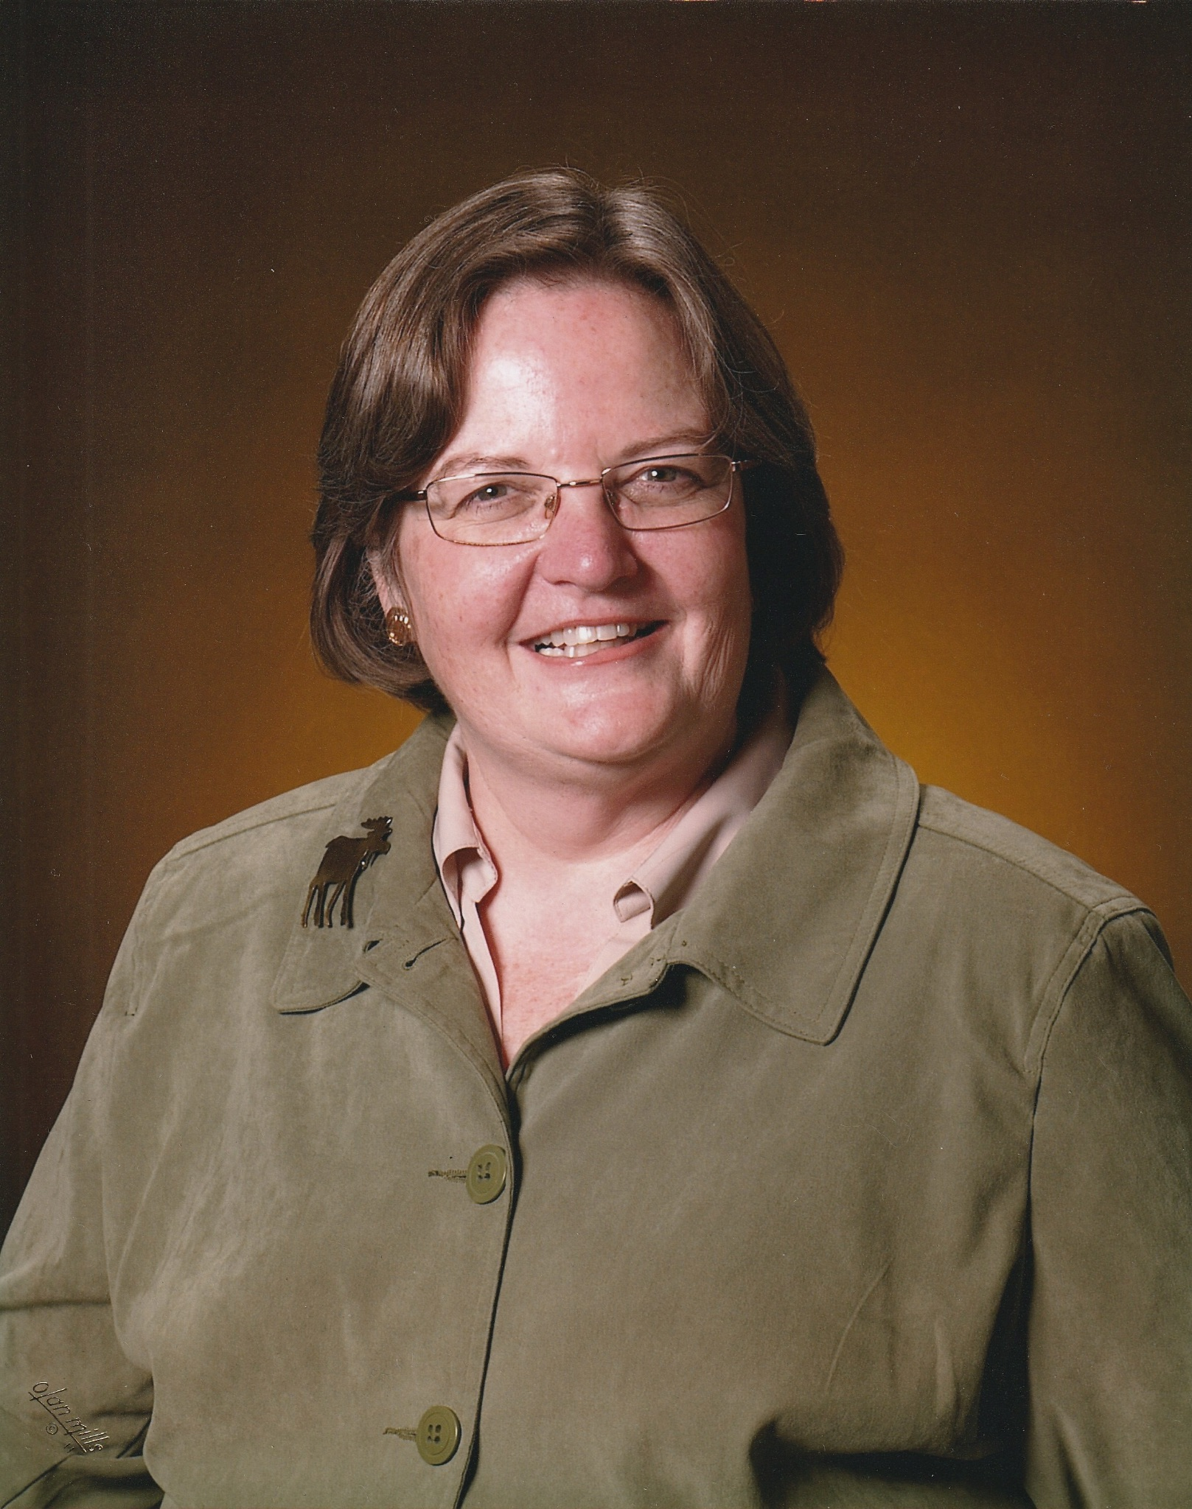
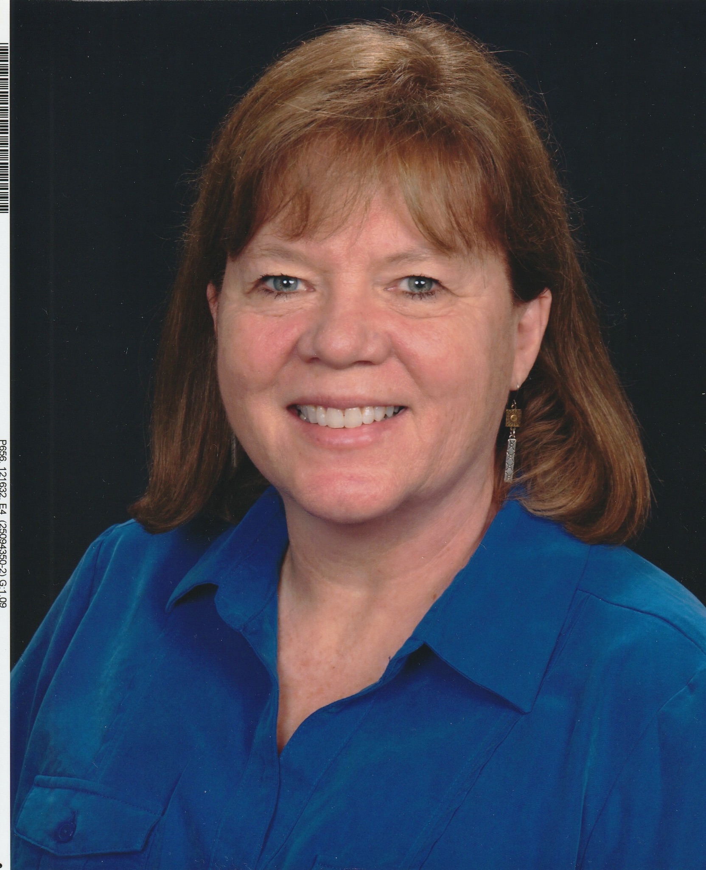
It’s in the Genes
Photo from: Patricia Overall
Notes:
Girls can do Math.
But Math is also in the genes—both the ability and the love of.
My father and grandfather both taught Math. My daughter is a math major and just retired as a professor at UMF teaching future teachers about Math and computers in the classroom. My younger daughter is a Computer Science major and retired as a Commander in the Navy working at various computer centers.

Slide 3
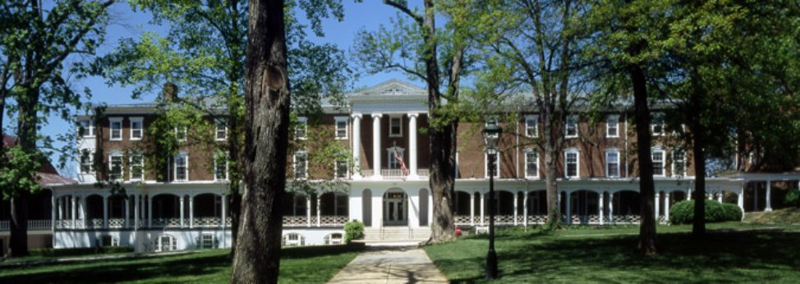
Photo from: https://alumnius.net/univer_photos/19580.jpg
Notes:
So, let’s start at the beginning. I graduated from Woodrow Wilson High School in Washington, DC in June 1949. I had been accepted at Hollins College for that fall. However, during my final semester at Wilson, my Air Force father received orders to Japan. At that time, dependents attending college were allowed to travel overseas to visit family for the summer practically free. However, they had to get themselves to the port on their own.

Slide 4

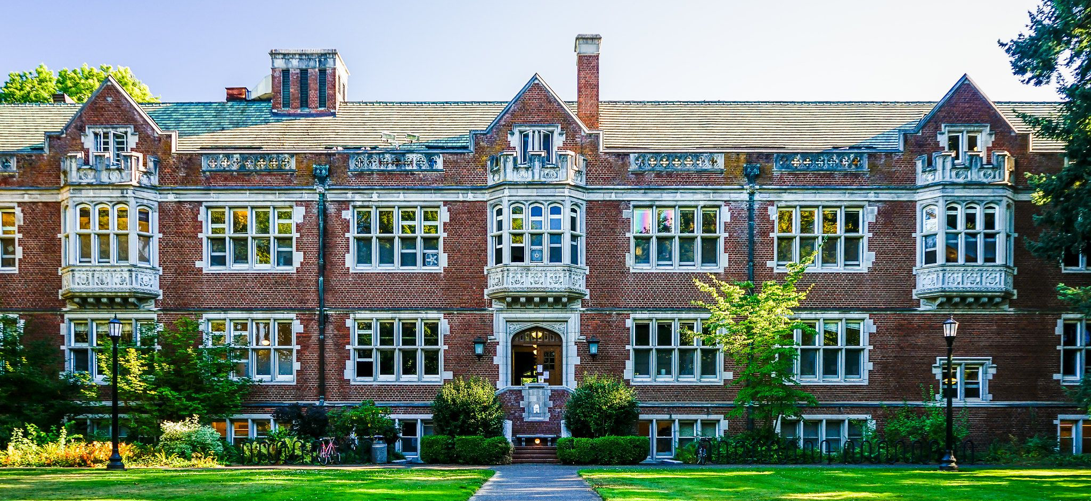
Photo from: https://www.thoughtco.com/thmb/v4JoyTyvjI22VfwE8aO6FgvkqVM=/2048x1365/filters:fill(auto,1)/36671911742_39c99900ab_k-a45cd53de5b243eb8e03ae919b0f08d2.jpg
Reed logo from https://www.pugetsound.edu/sites/default/files/styles/wysiwyg_300w/public/2021-06/ReedCollege_Logo.png?itok=nte8Z0S1
Notes:
So, I accepted the scholarship offered by Reed College in Portland, Oregon instead. At the end of my freshman year, I flew to Seattle and boarded a troop ship for Yokohama.

Slide 5
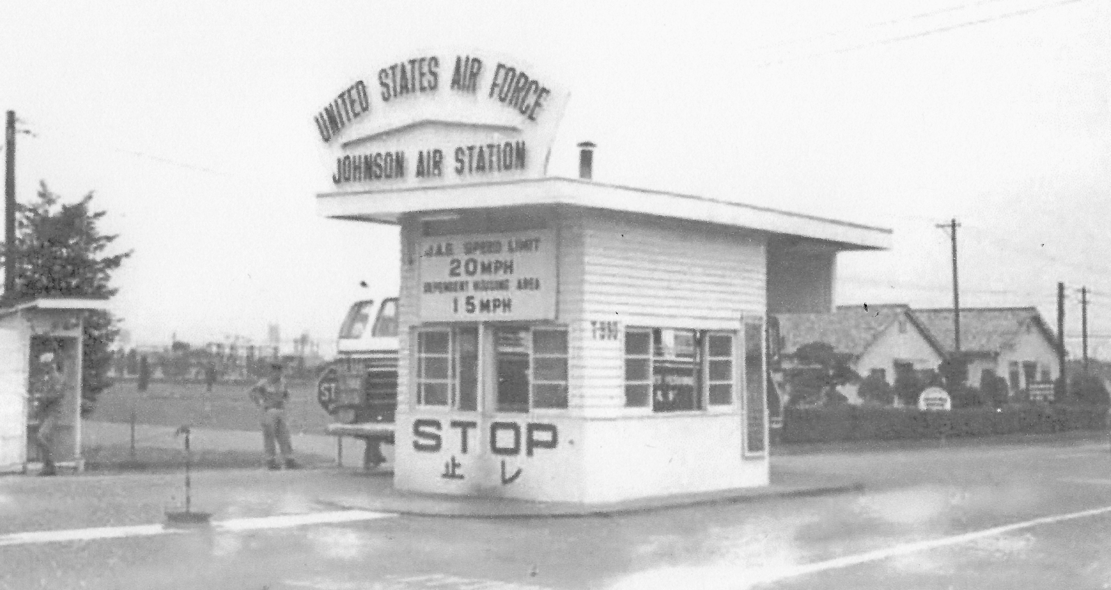
Johnson Air Force Base
Photo from: https://1.bp.blogspot.com/-OXfY-FFI5ts/XugexKLwstI/AAAAAAAAnBc/S8yDHS4UmmE98_GAyfPjqkot0grxeBy1ACK4BGAsYHg/s3544/johnsonAFBmaingate2.jpg
Notes:
I arrived in Japan the day the Korean War broke out. Everything changed. Most men from our base were sent away to set up bases for the war and many dependents were frightened about that and what might happen in Japan. We were told that dependents could go home but if things got better, they could not come back. My parents and I decided that we would stay. My father was away for several months but things did settle down and we lived on Johnson AF Base in Japan until 1952.

Slide 6

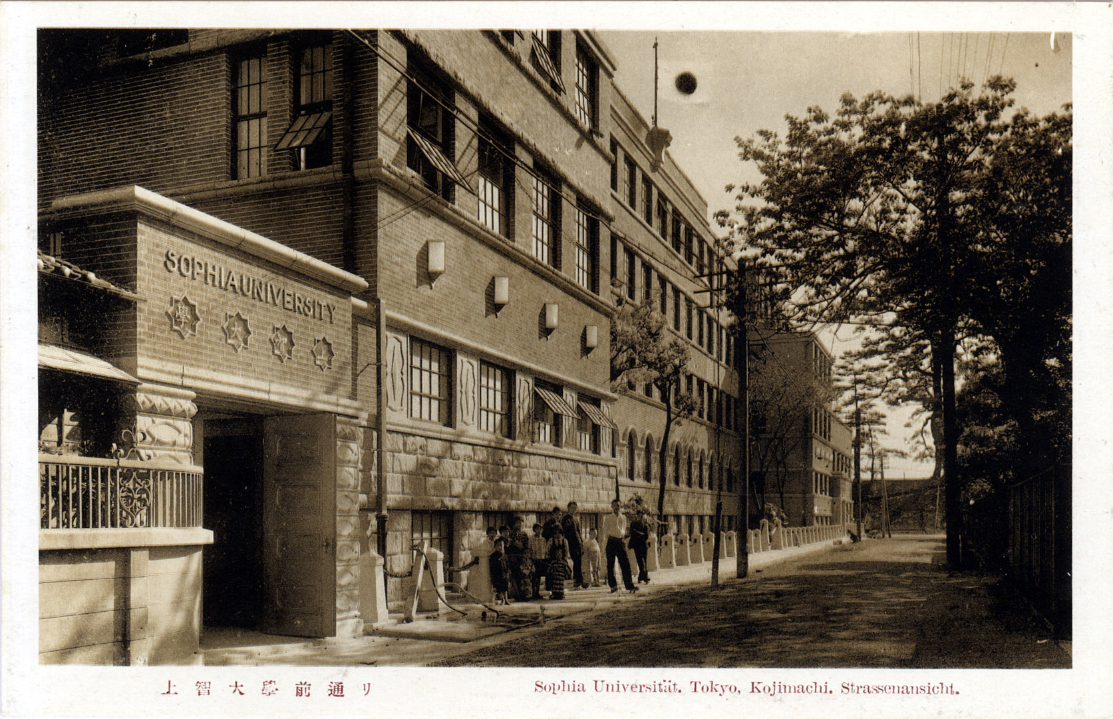
Photo from: https://www.oldtokyo.com/wp-content/uploads/2017/07/scan0015.jpg
Sophia logo from: https://seeklogo.com/images/S/sophia-university-logo-BED5224532-seeklogo.com.png
Notes:
I took college classes at Sophia University in Tokyo and on base at the University of California Extension. All at night. Sophia is a Jesuit college for boys taught in Japanese in the daytime. They formed the International Division at night for all those UN Forces people who were now stationed in Tokyo, as long as they spoke English. When we returned to The States my father was sent to Donaldson AFB in Greenville, SC.

Slide 7
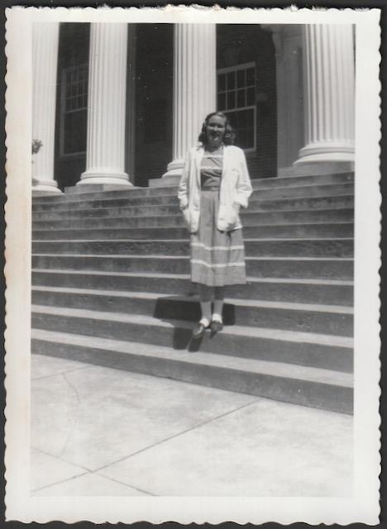
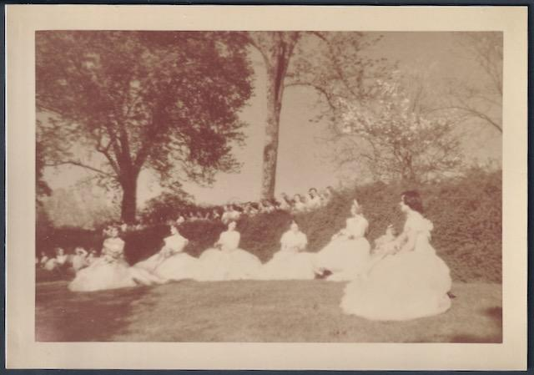
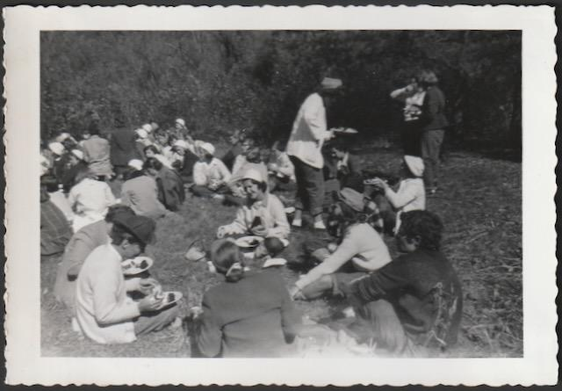
Hollins Memories
Senior Beer Jacket
Tinker Day
May Court
Photos from: Patricia Overall
Notes:
So, it made sense to come to Hollins after all. I was accepted as a conditional junior because I had such weird credits. I became a full junior in February after proving myself.
I wanted to major in Math and become a high school Math teacher. In order to do that I would be earning a Bachelor of Arts degree (the only one offered at the time) in Mathematics and Physics. Out of a class of 60 there were four of us on that track, two in Math and two in Physics.

Slide 8
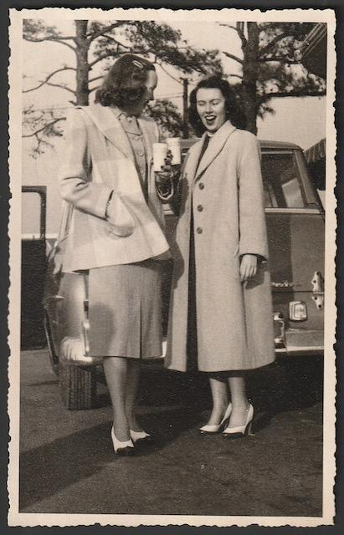
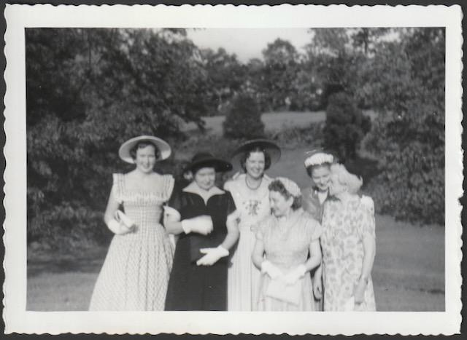
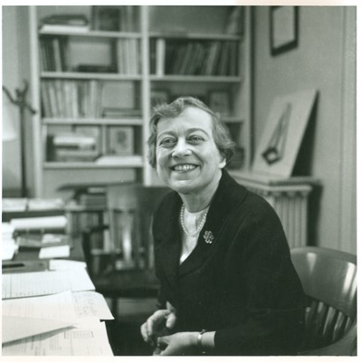
Hollins Memories
Spring Break with Classmate
Mrs. Freitag
Graduation with the Family
Mrs. Freitag Photo from https://digitalcommons.hollins.edu/finding_aids/1004/preview.jpg Other Photos from: Patricia Overall
Notes:
And I took just the few education classes available in order to earn a VA teaching certificate. I would be the 3rd generation Math teacher. Daughter Theresa is now the 4th.
I was recruited at Hollins during the spring semester of my senior year, 1954, to possibly work at NACA. How or why our school was chosen I don’t remember or probably didn’t know at the time. I suspect my wonderful major professor, Mrs. Freitag had a hand in that. However, I learned very soon that NACA had great interest in female mathematicians. Someone “upstairs” decided early on that if they found women who liked math, were good at it and had some training, they were more suited to these jobs than men.

Slide 9
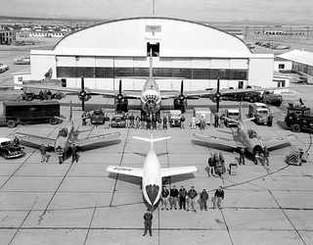
NACA
Photo from: https://www.nasa.gov/stem-content/naca-history/
Notes:
So—first thing to know—in 1954, it was the National Advisory Committee on Aeronautics! Founded by the US government in 1915, before WW I as flying became more common, available and necessary for the military. The original home and still a key headquarters is at Langley Air Force Base near Newport News, VA. Officially named at that time Langley Research Center. NACA became NASA (National Aeronautics and Space Administration) on October 1, 1958 as space-related projects began to outnumber straight aviation. The X-15 was developed by NACA and tested by Chuck Yeager on October 14, 1947. However, the USSR launched Sputnik on October 4, 1957, and that began the “space race”.
I decided the NACA offer was really intriguing, so I decided to postpone my teaching career and said I was interested. I went through some orientation to be sure I wanted to do this. Yes. Then some paperwork, not near as much as today, and getting a clearance. I could have started right after graduation but I really wanted that summer off to play.

Slide 10
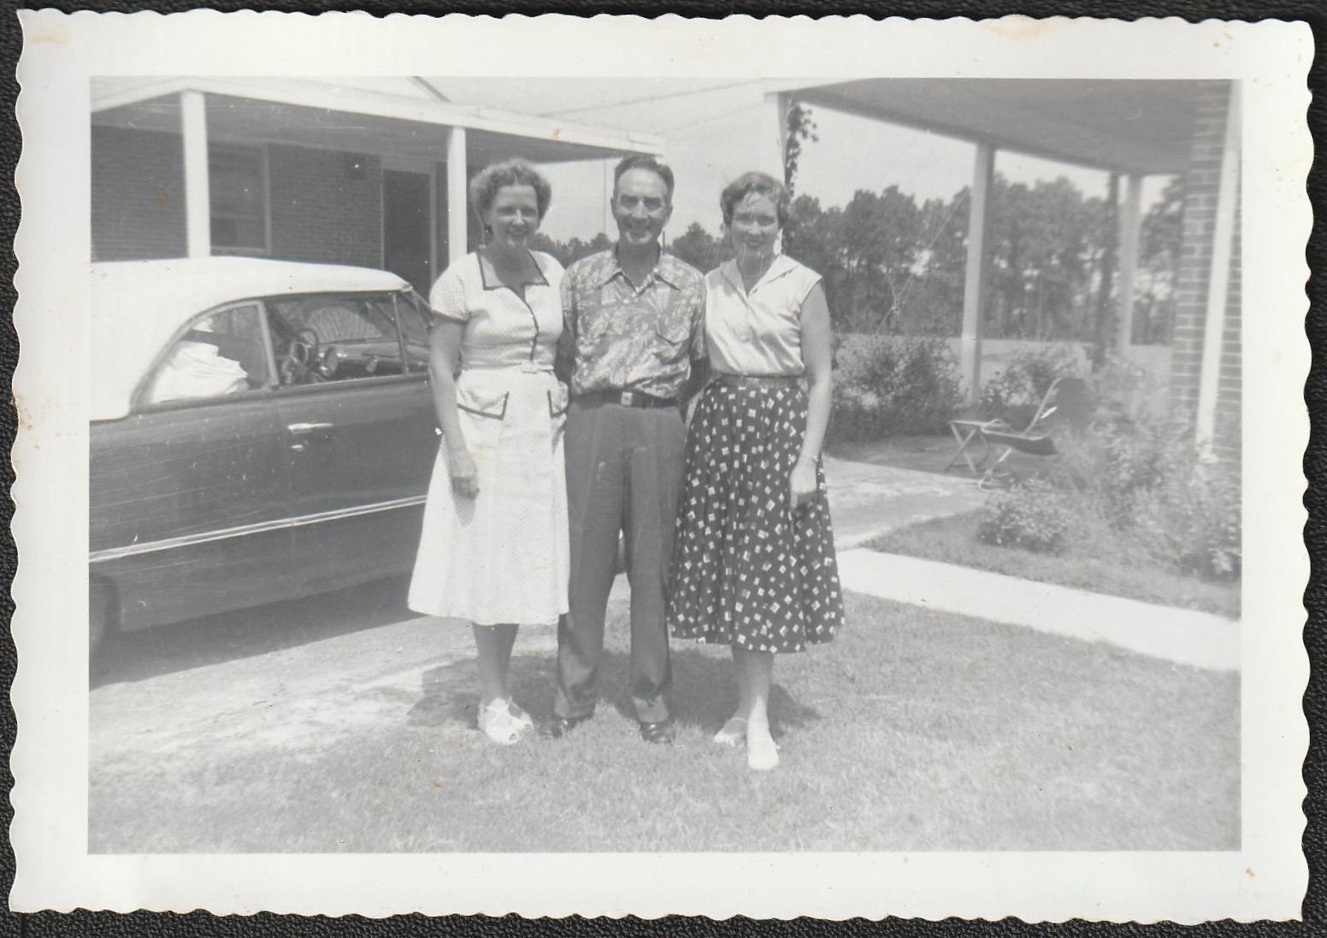
Last Summer Vacation
Photo from Patricia Overall
Notes:
The personnel department approved everything and we agreed that I would start the day after Labor Day.
I spent that summer living on base at Ft. Bragg, NC, where my father was newly stationed at Pope AFB. As a young girl I had loved living on base and all that went with it and figured I would never have that opportunity again. Dating paratroopers instead of fighter pilots was pretty cool. We lived on the air base which housed the 4th Fighter Wing.
I had the use of my parents’ 1949 Ford convertible at college my final semester in order to do my practice teaching at Roanoke High School. That summer I made a deal with my father to buy that car on time and at no interest. And so, I headed out and drove to Langley in September.

Slide 11
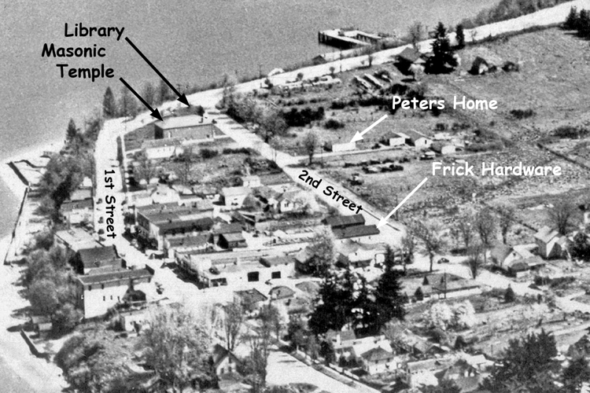
Moving to Hampton, Virginia
1950. Aerial view of Langley (Courtesy South Whidbey Historical Society).
Photo from: http://langleyhistory.org/data/historycurrent.html
Notes:
I had a college friend who had married an AF ROTC grad from VMI and they were living on base. I was invited to stay with them until I got settled. I really lucked out in finding a two-bedroom apartment with 3 other NACA ladies whose 4th roommate had just moved out to get married. However, within a couple of months, two of the others decided to move on for different reasons so the one remaining and I moved into a much smaller one-bedroom apartment together. She worked in a different section/area of NACA and we never became great friends but it was a comfortable working arrangement and certainly helped with expenses. Our apartment was in Hampton, a smaller city between Newport News and the air base.

Slide 12
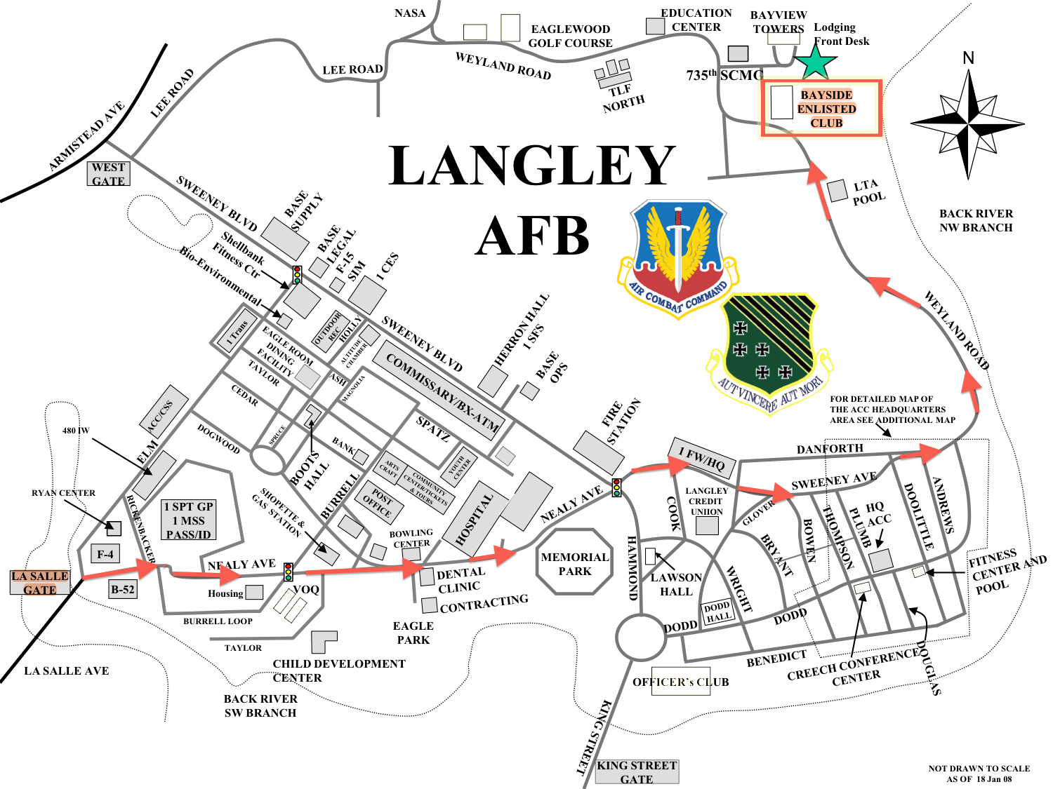

Life at Langley
Photos from:
•https://www.spacea.net/images/langley-afb-map.png
•https://www.historypreservation.com/products-page/brands/buzz-rickson-langley-air-force-base-sweatpants/
Notes:
One reason we didn’t do a lot together was because our social lives were totally different. I was back to dating fighter pilots. My father was on the staff of 9th Air Force at Shaw AFB in SC. After I left home, the whole of 9th AF was transferred from Pope to Shaw AFB near Sumter, SC. That was under the major unit TAC (Tactical Air Command), which was headquartered at Langley AFB. (You may have heard of SAC {Strategic Air Command and General LeMay}. This meant that “The Colonel” (aka my dad) came to Langley from time to time on business and would take me to dinner at the Officers Club. He got chummy with the Club Officer and arranged for me to have a membership there. I went to dinner on my own then and began to make friends.
I reported to personnel for orientation and assignment. Because I had a minor in English, they wanted me to be a tech writer.

Slide 13

Not a Tech Writer
Photo from: https://wikiasking.com/wp-content/uploads/2024/02/15451-how-did-the-writers-of-the-office-come-up-with-michael-scott-s-character-768x432.jpeg
Notes:
No! My English minor was based on my love of 19th century English literature. A writer I was not. So, just by luck I ended up in this brand-new department using IBM computers.
At that time the government had two tracks of classifications: GS and P. Today there is only one classification, everyone is a GS. I was a P because I was a college graduate, would be management and a so-called programmer. We had so-called keypunch operators and they were GS. When I went home to visit for the first time, of course, my parents were all interested in what I was doing in this mysterious new job. I told them I was a computer programmer and, of course, the immediate reaction was “What on earth is that?” It took some explaining but my father was fascinated.

Slide 14
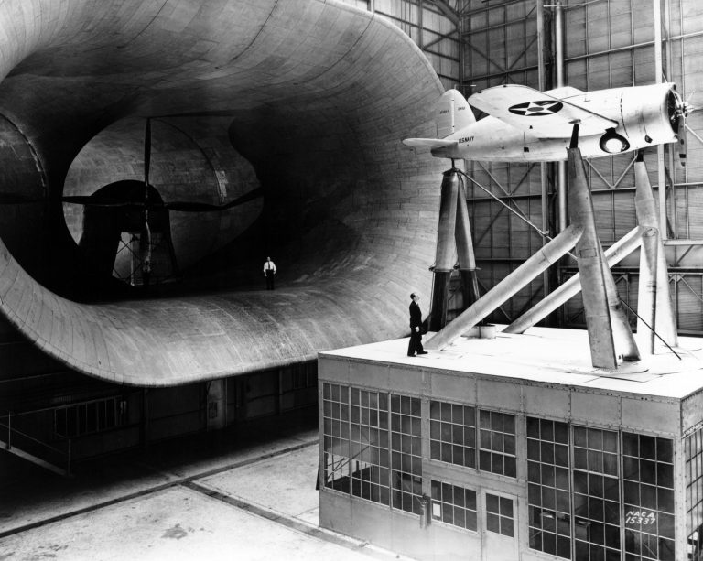
Langley Facility
Photo from: https://www.thisdayinaviation.com/2-december-1937/f2a_in_langley_wind_tunnel_1938/
Notes:
The Langley facility consisted of a large number of wind tunnels in various sizes and shapes and functions. These were operated by engineers who would test various airplane parts to see if the design performed as predicted. In the wind tunnel they would put sensors on the wing or flap or whatever they were testing. The engineers would change the wind factors to test the various strength of those parts in different wind conditions. Those sensors would output large quantities of data that was then processed by hand on large Friden type calculators, mostly by female mathematicians. And those engineers really loved their slide rules.
The tunnels were operated by male aeronautical engineers and female mathematicians (always referred to as girls).

Slide 15
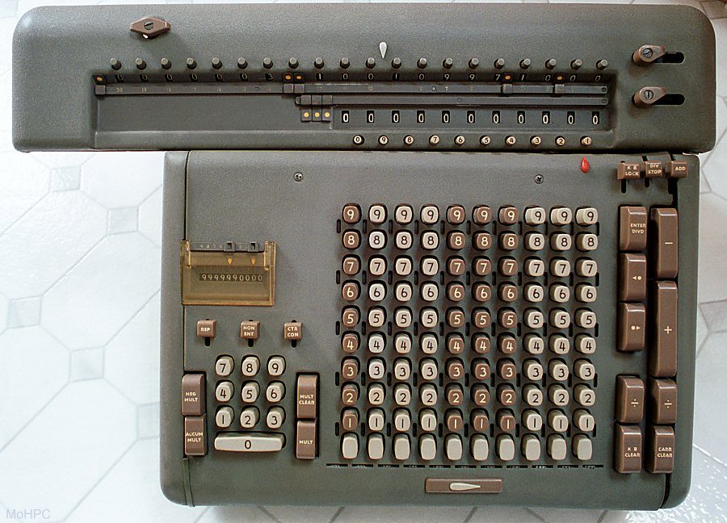
Doing the Math
(Friden Desk Calculator)
Photo from: https://www.hpmuseum.org/big/friden.jpg
Notes:
All the math needed for the wind tunnel experiments had been calculated by the female mathematicians using those Friden type large desk calculators and still was. As a new female mathematician, I was offered the position of a programmer and discovered a whole new world. The computer center had eight programmers (all female), two supervisors (male), and about a dozen key punch operators (both male and female).
IBM was anxious to get a foot in the door with NACA so they had made a good deal for the rental of all our machines and assigned two of their own engineers to our department to oversee installation and familiarization. IBM never sold their machines in those days. The 604 rented for $645 per month in 1948 dollars. These two men were there full time and indefinitely—nice guys and very helpful. They wore suits and ties as did everyone in the department.

Slide 16
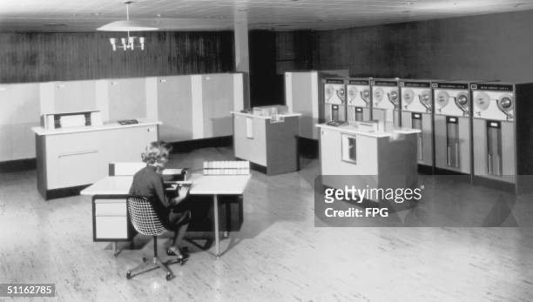
UNIVAC Filling a Computer Room
Photo (used with Education Fair Use Guidelines) from https://www.gettyimages.com/detail/news-photo/technician-at-work-in-a-univac-computer-room-circa-1955-news-photo/51162785
Notes:
Interestingly, there was a huge UNIVAC machine upstairs which we sort of replaced. I think most of us remember that acronym name from our early days. It was already becoming obsolete.
Sidebar: Let’s go back to 1890, a census year. The 1880 census had taken 8 years to process. Not acceptable. In the late 1880’s a man named Herman Hollerith, inspired by train conductors using holes punched in different positions on a railway ticket to record traveler details, invented the recording of data on a machine-readable medium.

Slide 17
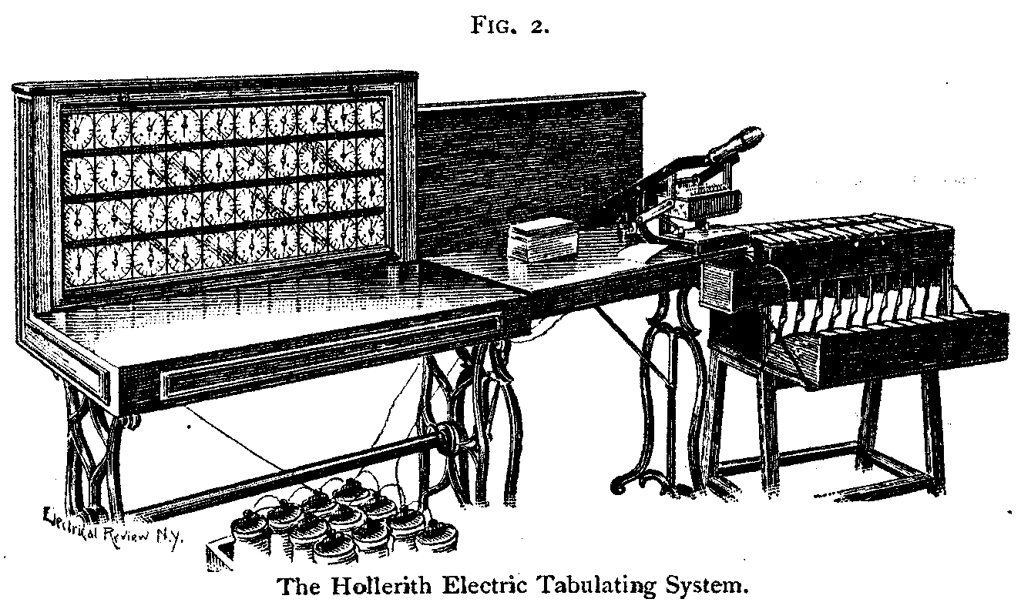
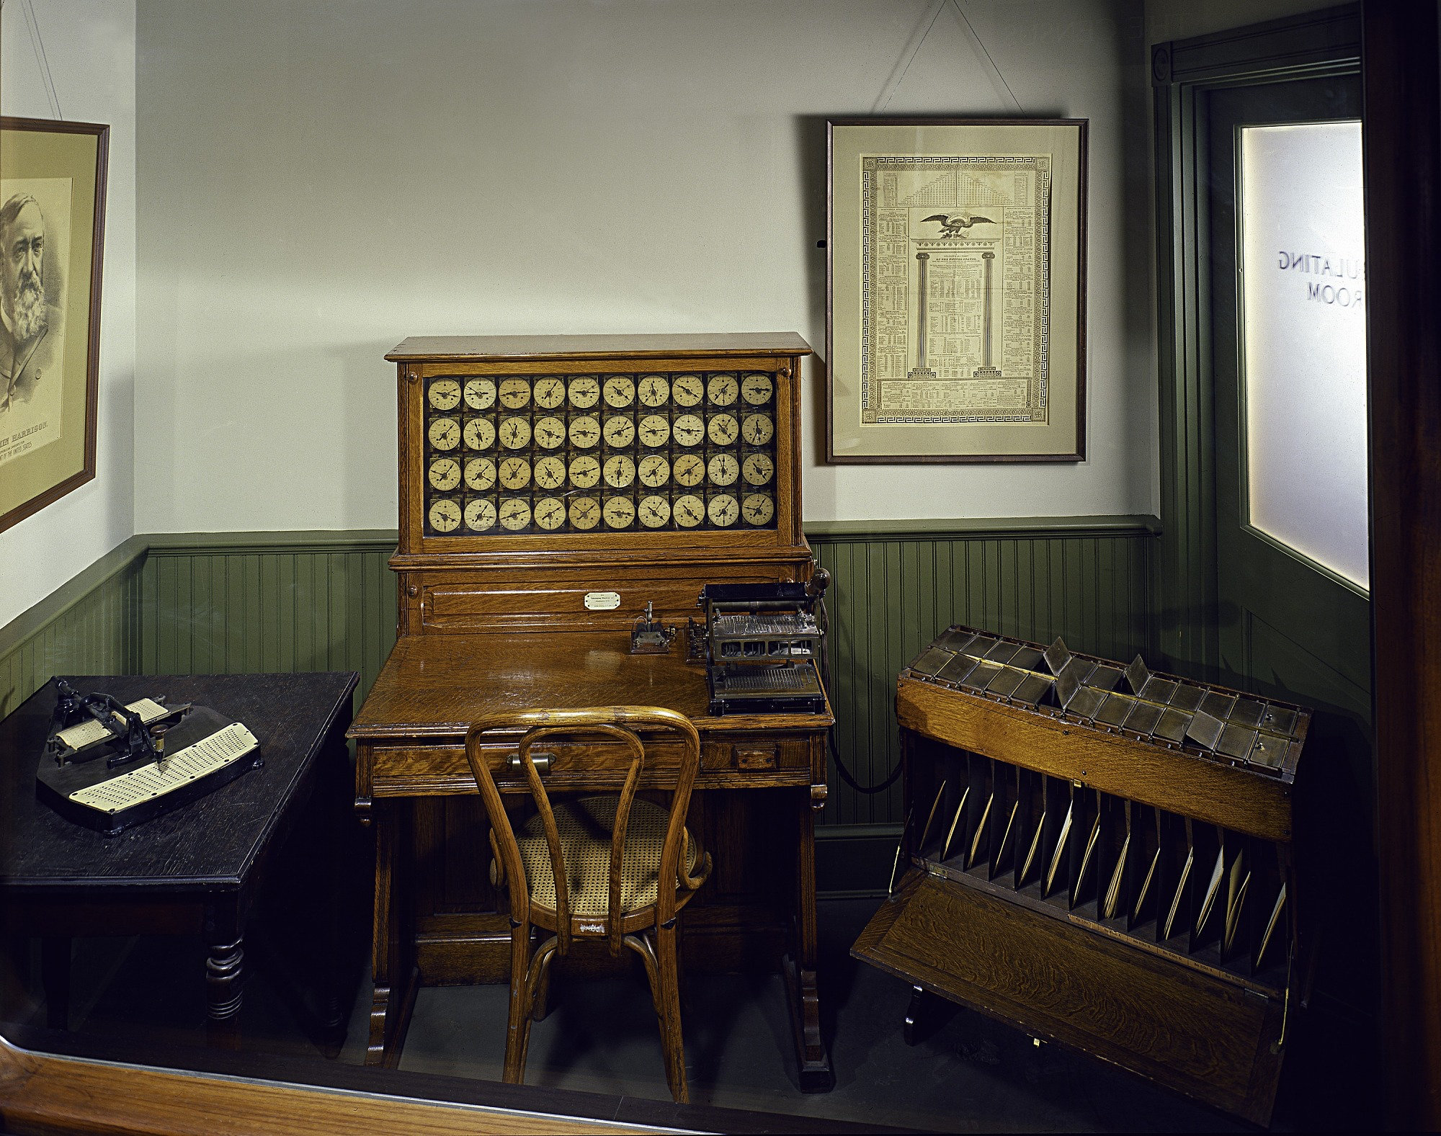
Both sides of the family
The Hollerith Tabulating Machine
Black and white photo from http://www.columbia.edu/cu/computinghistory/hh/
Color photo from: https://ids.si.edu/ids/deliveryService?id=SIA-79-10952
Notes:
After some initial trials with paper tape he settled on punched cards. Long story short, he started his own business as the Hollerith Electric Tabulating System, specializing in punched card data processing equipment. Then he introduced the Hollerith Integrating Tabulator which could actually add numbers together, not just count the holes. This machine was used in the 1900 census. And who do you suppose worked on that census as a temporary summer job? My maternal grandmother. All she and her co-workers did was the hole-punching. That side of my family was not mathematically inclined. A funny story my mother told well after Nana passed away--At her wedding, some of those co-workers poured yellow confetti from those holes into her honeymoon suitcase.
Continuing Sidebar: In 1911 four corporations including Hollerith’s firm were amalgamated to form a new company, the Computing-Tabulating-Recording Company (CTR). In 1924 CTR was renamed International Business Machines (IBM).

Slide 18
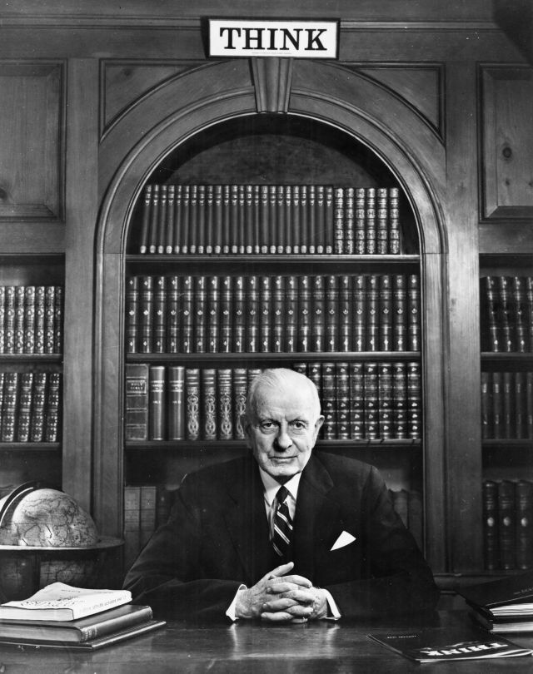

IBM
Thomas Watson Sr. photo from: https://www.ibm.com/history/think
IBM logo from: https://www.ibm.com/history/logo
Notes:
And so, we come to Thomas John Watson Sr. (February 17, 1874 – June 19, 1956). He was an American businessman who was the chairman and CEO of IBM. He oversaw the company's growth into an international force from 1914 until he died in 1956. Watson developed IBM's management style and corporate culture from his training when he worked at National Cash Register (NCR). He turned the company into a highly effective designing and selling organization, based largely on punched card tabulating machines.
Among other things he authorized providing Hitler's Third Reich with data processing solutions and involved IBM in cooperation with Nazi Germany throughout the 1930s and until the end of World War II. So he was profiting from both the German and American war efforts. A leading self-made industrialist, he was one of the richest men of his time when he died in 1956. The home office and plant were and still are in Armonk, NY, 37 miles north of NYC. He created and patented the motto “THINK” which was and still is hanging in every IBM facility worldwide. He was still very much an active leader and a rigid taskmaster when I worked at NACA.

Slide 19
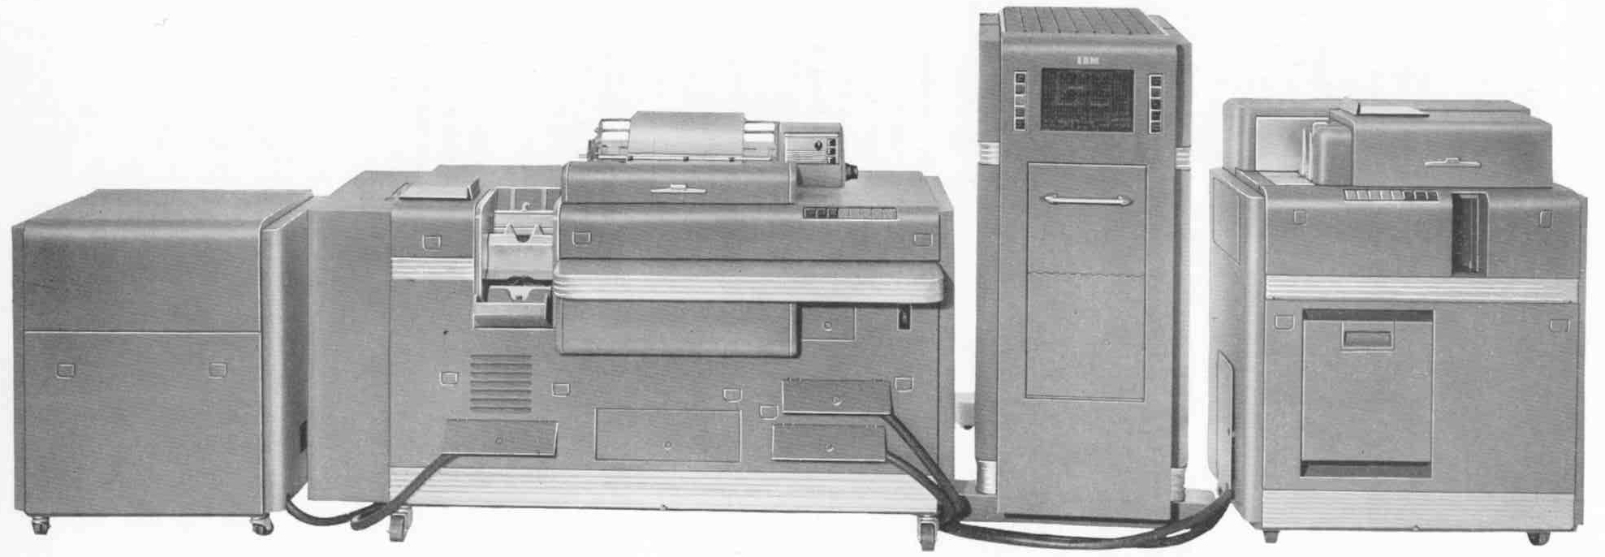
The CPC
Photo from https://www.columbia.edu/cu/computinghistory/cpc-wide.jpg
Notes:
Back to more modern times: Our department was populated with three 604’s (calculators), 4 or 5 402’s (printers), and a CPC (Card -Programmed Electronic Calculator) which was a combination of the 604, the printer and external memory. Needless to say, all this power generated a lot of heat. Our department was mostly one big room for the machines with cubicles around the edges for our individual desks. Along the outside wall there were three huge air conditioning units which ran 24/7 and 365 days. We wore a lot of sweaters.
Although the CPC was considered more complete, it was huge and a noisier system than the individual machines. And several operators could be working on several projects on several of our machines, whereas the CPC did just one project at a time. And so, I was introduced to the machine of choice, the IBM 604 Electronic Calculating Punch.
This machine was first introduced in 1948 and used until 1958.

Slide 20
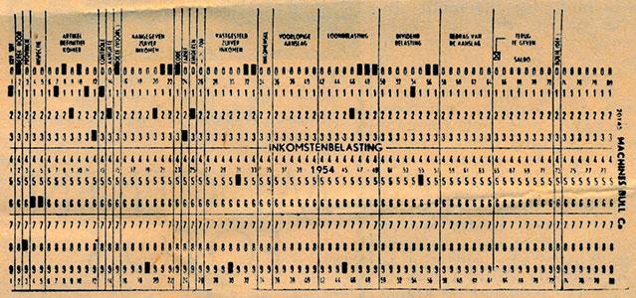
Punch Cards
Photos from https://ub.fnwi.uva.nl/computermuseum/604.html
Notes:
Punch cards were used for the data they sent to us from the wind tunnels and other experimental areas. The 604 was programmed using plug boards and “master” cards. These punched cards were interspersed in the trays and contained the constants for the related equations represented. They were then used to compile the data required from the data cards. The results of the computations were punched into the data cards. After we did the programming and verifications, the keypunch operators would run the trays of cards through the machines for calculations and the final data was punched into the data cards. Then they would print results as needed. There was extremely limited “storage” of digits as these calculations were run. It took one full pass through the machine just to do square root.

Slide 21
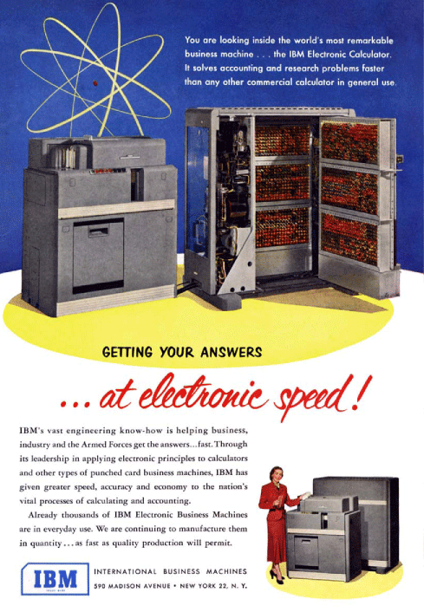
IBM Sales
Photo from https://i0.wp.com/www.technologizer.com/wp-content/uploads/2010/08/ibm-gettinganswers.jpg?resize=560%2C777
Notes:
Part of the job was to “sell” the engineers on using our systems to process their data. Some were very reluctant at first. They would be sent to meet with one of us and we would sit down with them and their equations, sample data, etc. Then we had to show them and convince them that we could process things better and faster than they were used to.
Because the machines were so expensive as well as the cost of lighting and cooling the room, we worked in two shifts to get more use out of the machines.

Slide 22
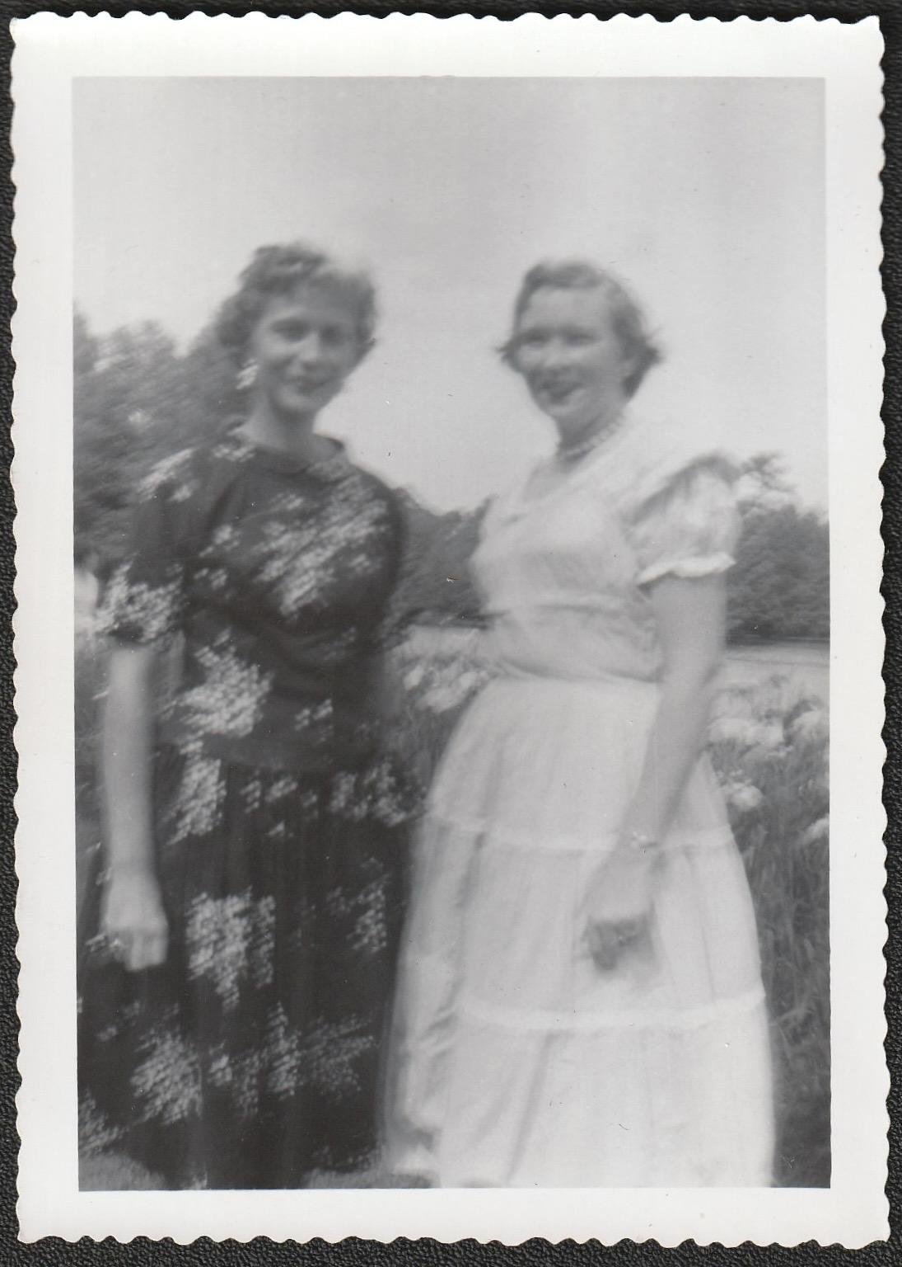
Working Shifts
Patricia and fellow programmer Janet
Photo from: Patricia Overall
Notes:
There were four teams of two programmers and three keypunch operators per shift. Three teams worked day shift and one worked the night shift from 3:30 to 11:30 pm. (There was no graveyard shift.) Life was challenging during those night shift weeks because by the time your body clock was oriented to this schedule, you were off of it. But it was nice to have some free time in the days to go to the laundromat, bank, doctor, etc.

Slide 23
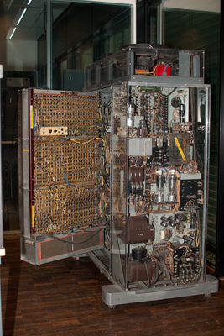
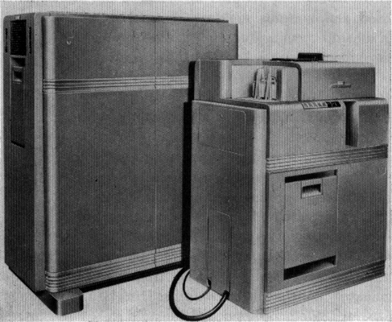
A Closer Look at The IBM 604
The “inside” of the Arithmetic Unit
LEFT: Card Reader/Punch Unit
RIGHT: Arithmetic Unit
604 photo from: https://ub.fnwi.uva.nl/computermuseum/604.html
Arithmetic unit photo from: https://ub.fnwi.uva.nl/computermuseum/pictures/IBM604open_400.jpg
Notes:
The 604 consisted of two units. The card reader/punch unit was a large unit (about 6 feet by 6 feet by 3 feet) filled with about 1100 vacuum tubes and 125 relays. It weighed 1,949 pounds. There was a place where the operator dropped in a stack of punch cards that held the data and another where they later removed them. I rarely touched this unit except to feed cards on occasion, though I saw the inside of it whenever the “guys” (i.e., what today would be called technical support) opened it up to work on it.
The arithmetic unit was tall enough to stand at comfortably (about a foot taller than me at 5’8”). On the front there was a window through which the operator could look at a series of lights (each light represented one of the vacuum tubes in the machine) and check the binary programming. What’s binary you ask? Our decimal system is base ten. Binary is base two. This language is used mainly in computers still today, and is made up of only 0’s and 1’s. Thus, light off is zero and light on is one.

Slide 24
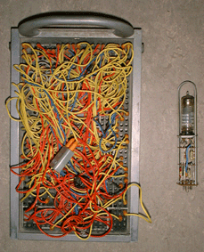
The Plugboard
Photos from: https://ub.fnwi.uva.nl/computermuseum/604.html#close
Notes:
Below that window there was a removable panel that we called the plugboard. I could take this piece to my desk to do the actual programming. I would have first worked out the formula with the engineer and converted it to binary. Then once that was done, I could connect wires from digital input to the output section.
The plugboard had holes and the wires had metal ends on the that snapped into place. The wires were color-coded by length. It was similar to a telephone switchboard in its ease of use compared to earlier plugboards. There were 80 columns of holes on a punch card. These were all pre-identified in the wind tunnel. Each wire represented one of those holes. The first number that you wanted to use, you read into the first storage unit by plugging one wire for every digit in the number, which you then wired from there into the calculating unit. Then you would read in another number using the same process. The next step would be to tell it what calculation to perform with those two numbers and in which storage unit to place the answer. In a typical application, the machine was configured to accept 7 fixed-point numbers of 5 decimal digits at a time, leaving one storage unit free for the result of a calculation. The machine could only be programmed to do addition subtraction, multiplication or division. It could do 64 calculations on one pass.

Slide 25


Hidden Figures
Book jacket photo from: https://i.cbc.ca/1.3843676.1478715666!/fileImage/httpImage/image.jpg_gen/derivatives/original_780/hidden-figures-margot-lee-shetterly.jpg
Theatrical release poster photo By Twentieth Century Fox - http://www.blackfilm.com/read/wp-content/uploads/2016/08/Hidden-Figures-poster.jpg, Fair use, https://en.wikipedia.org/w/index.php?curid=51342178
Notes:
I’m sure many of you are familiar with the movie “Hidden Figures”. Really a great movie, and the book is even better. Interesting sidelight to my story. Those ladies were there starting in the 1930’s and remained there, segregated, through the 1960’s. I arrived in 1954. I never saw a black face the whole time I was there. NACA/Langley was a federal facility but Virginia was maybe the most segregated state in the south at that time. It was so great to see them featured and honored in the book and movie but far too late. It’s nice that they have gone on to be honored in several ways since. I think they were all sharper than me or any of my colleagues. But I never knew anyone outside my own department except those roommates. We were quite isolated.

Slide 26
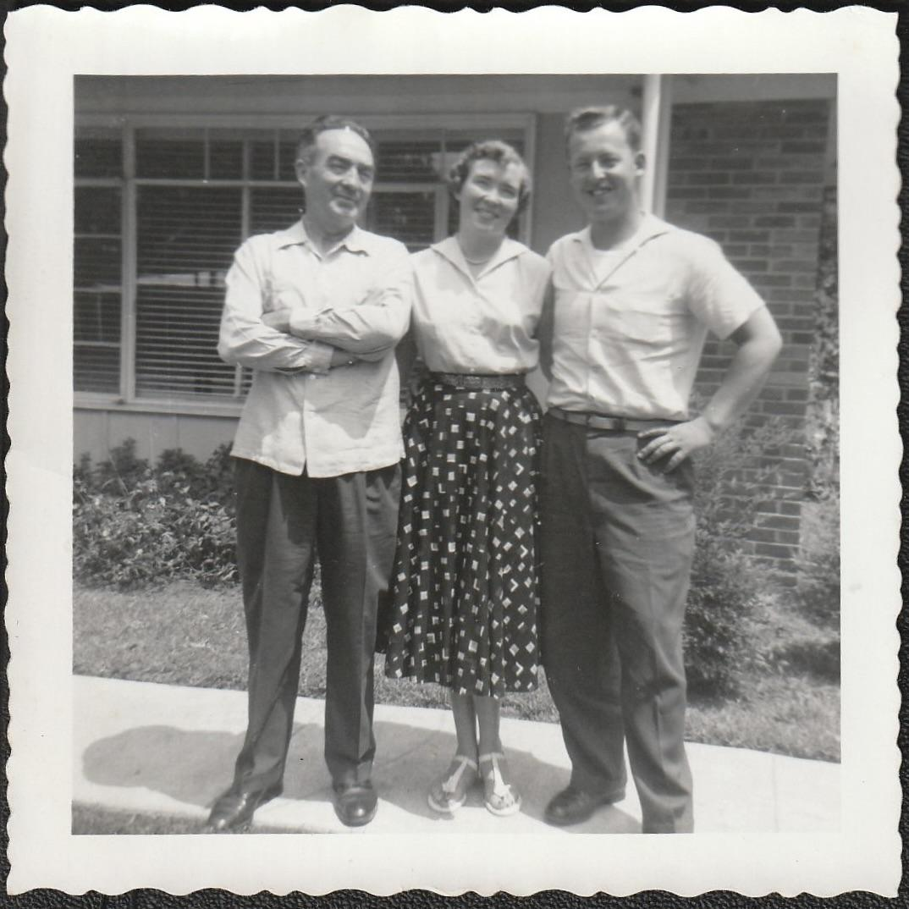
Time to Move On
Photo from Patricia Overall
Notes:
After I had been there about nine months, the 650 arrived. This was IBM’s newest and finest computer. It used drum storage and so allowed for much more calculating and storing of digits in one pass. But still using punch cards. We just got the one machine and the more senior programmers were trained on it. I was still using the 604. And so it went.
And then like so many before me I quit to get married—to one of those fighter pilots.

Slide 27
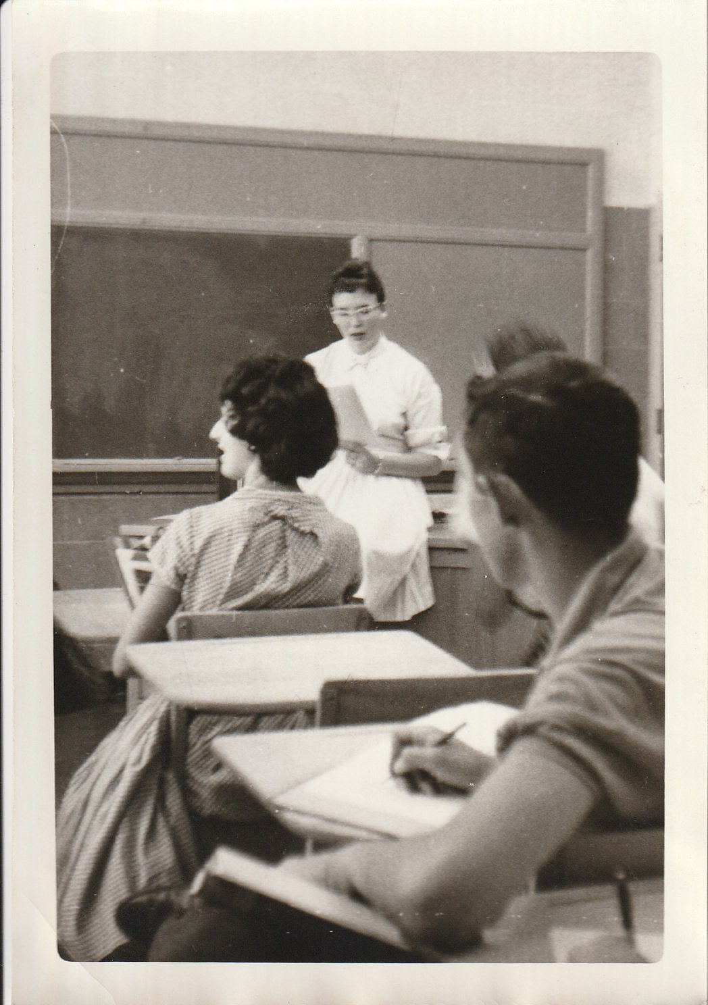
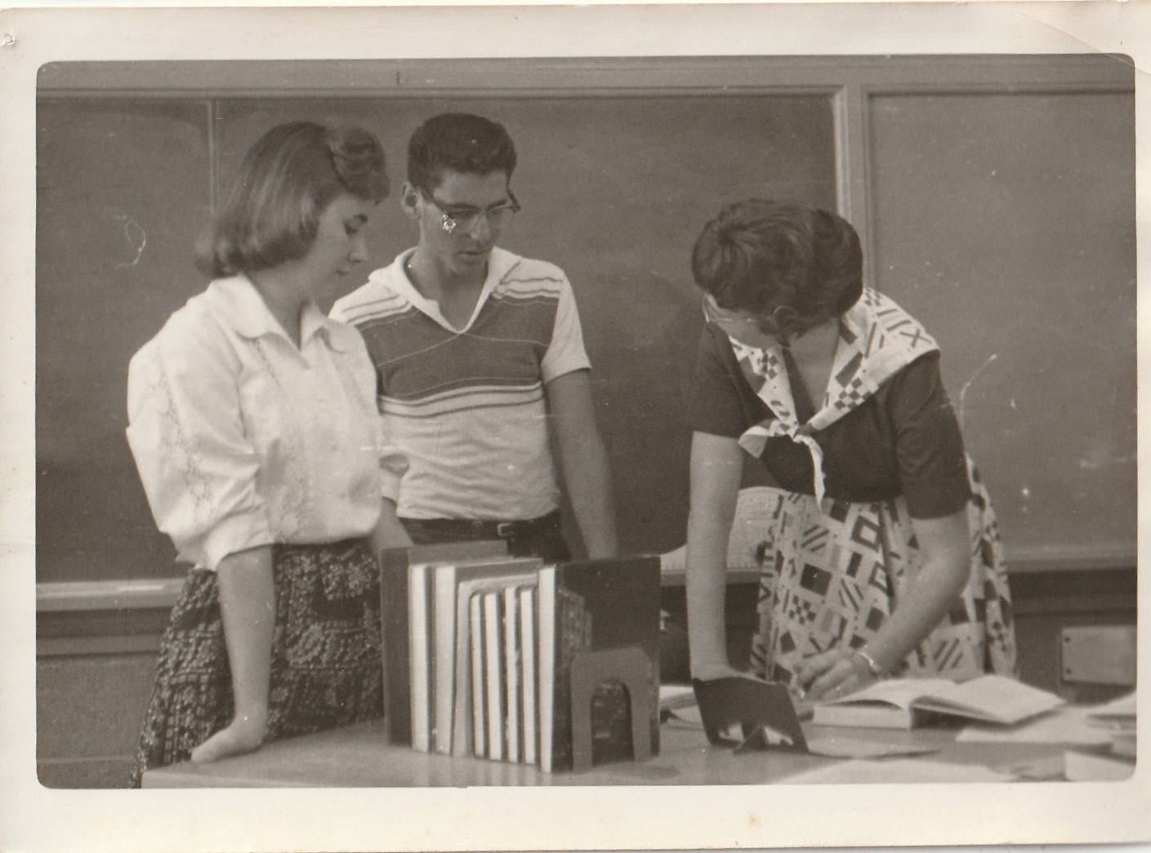
Santa Fe High School Math Teacher
Photos from Patricia Overall
Notes:
Postscript—In 1960 when I was teaching Math at Santa Fe HS in NM, I was able to take some of my students on a field trip. My brother-in-law was what I called a “charter employee” at Sandia Laboratories in Albuquerque. Sandia is directly related to Los Alamos in nuclear development. He arranged for me and my Algebra 2 students, juniors, to visit Sandia’s computer department. They were using IBM also. By then their machines were using tape deck storage. Huge reels of very wide tape which were capable of more than double the storage of the 650. Then as now, as soon as it’s in use it becomes obsolete.
Also, in the early 60’s, hand held calculators were emerging. So in just a few years I was pointing out to my students that while it took the 604 all of its 64 program steps to calculate square root, they could do that by pushing one button on a very small device.

Slide 28

Passing It On
Meme created at: https://imgflip.com/memegenerator
Notes:
As a high school teacher, I very much enjoyed being able to share some of my background and enthusiasm with my students. I taught General Math and Plane Geometry as well as Algebra 2. And I found, in both boys and girls, curiosity and interest within these different levels of Math in all of those classes. All of which allowed me to once again climb on my soap box “Girls Can Do Math”.

Slide 29
Thank You
What questions do you have?
Feel free to contact me:
abqpdo@gmail.com

Slide 31
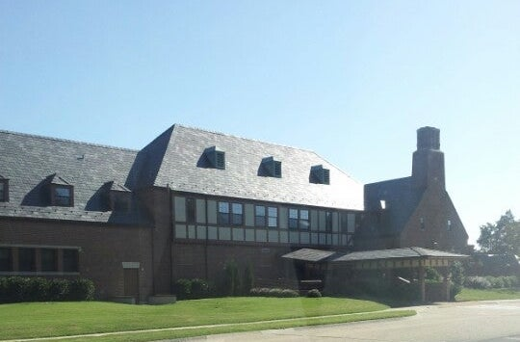
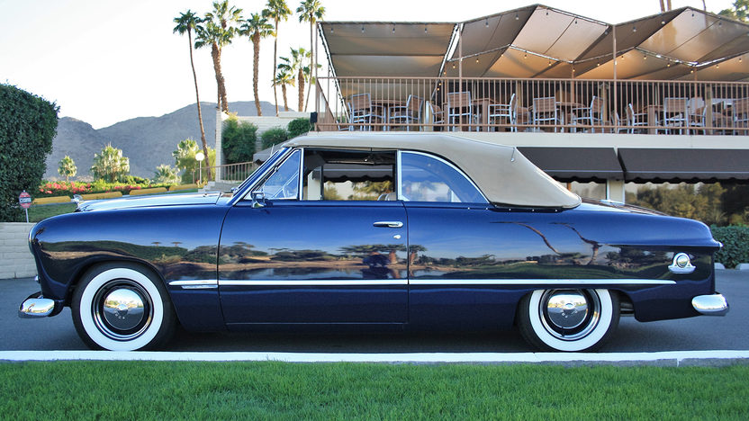
https://foursquare.com/v/langley-afb-officers-club/4df3e50818a88611c6be4fc9?openPhotoId=507865e1e4b0753d58ef4eeb

Slide 32
IBM 604
Photo from https://ub.fnwi.uva.nl/computermuseum/604.html

Slide 33
Instructions for use
If you have a free account, in order to use this template, you must credit Slidesgo by keeping the Thanks slide. Please refer to the next slide to read the instructions for premium users.
As a Free user, you are allowed to:
Modify this template.
Use it for both personal and commercial projects.
You are not allowed to:
Sublicense, sell or rent any of Slidesgo Content (or a modified version of Slidesgo Content).
Distribute Slidesgo Content unless it has been expressly authorized by Slidesgo.
Include Slidesgo Content in an online or offline database or file.
Offer Slidesgo templates (or modified versions of Slidesgo templates) for download.
Acquire the copyright of Slidesgo Content.
For more information about editing slides, please read our FAQs or visit our blog:
https://slidesgo.com/faqs and https://slidesgo.com/slidesgo-school

Slide 34
Fonts & colors used
This presentation has been made using the following fonts:
Tilt Warp
(https://fonts.google.com/specimen/Tilt+Warp)
Hind
(https://fonts.google.com/specimen/Hind)
#dbebce
#d1e0c5
#c0dabb
#aebea3
#7d8a75
#222423

